Slide 1
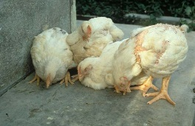
poultry diseases
fourth stage
شعار الكلية
يمكن اضافة صورة تتلائم مع اسم المادة
chapter one – Nutritional Deficiency Diseases- lecture 5
Fatty Liver and Kidney Syndrome
Dr.Harith Abdulla
Department of Pathology and Poultry Disease
College of veterinary medicine university of basrah
University of Basrah- College of veterinary medicine- Department of Pathology and Poultry Disease

Slide 2
Fatty Liver and Kidney Syndrome (FLKS)

Slide 3
Definition:
Fatty Liver and Kidney Syndrome (FLKS) in young
flocks : Is a manifestation of a failed metabolic
process allowing accumulation of fat in the liver
and kidneys.
Fatty liver in adult poultry flocks is commonly
caused by the inadequate addition of biotin
and/or choline chloride in the feed.

Slide 4
Morbidity: Occurs rapidly in affected chickens and is followed quickly by death.
Mortality : May vary from 5-35% .

Slide 5
Clinical signs:
1-The bird is , isolated and often die in a sitting position.
2-Incoordination.
3-Head movement.
4-The chicks may lie on their breast with their
neck and legs extended.

Slide 6
Post-mortem lesions:
1-The liver and kidney are markedly enlarged, pale
and fatty. The liver may be yellow.
2- Abnormal deposits of fat in the subcutaneous
tissues, abdominal cavity and visceral organs.
3-Weights and sizes of liver, kidney and heart
increased, whereas the weight of thymus decreased.
4-The liver is very fragile and easily ruptured causing
internal bleeding.

Slide 7
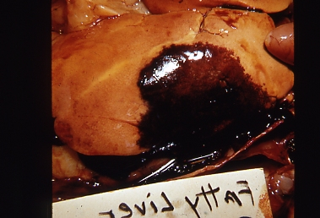
This image showing the typically fragile and bleeding liver with yellowish fat accumulations.

Slide 8
Treatment:
Biotin via the drinking water.

